Slide 1
Anchor Modelling
Agile DBs
Sixth Normal Form databases!

Slide 2
Yes, there are normal forms after 3!

Slide 3
Yes, they can be useful!

Slide 4
Yes, I’m gonna explain myself! But first…

Slide 5

Steph Locke
Locke Data founder
Data Science & DataOps focus
Microsoft MVP
Author
@stefflocke

Slide 6
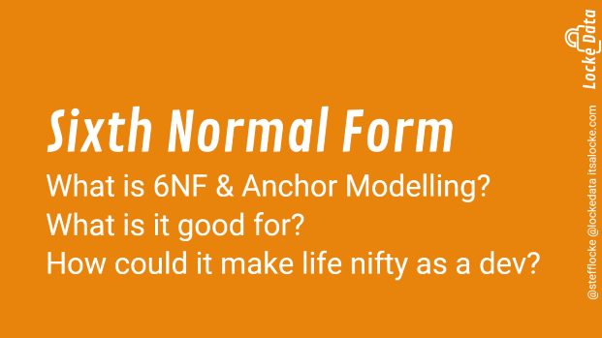
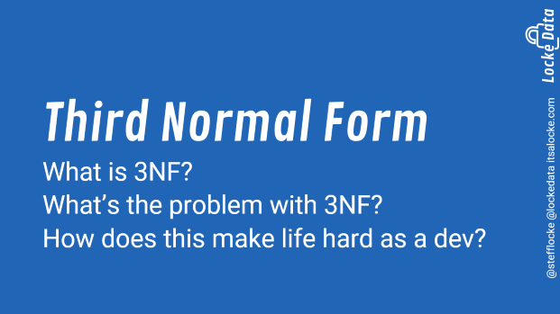
Agenda

Slide 7
Third Normal Form
What is 3NF?
What’s the problem with 3NF?
How does this make life hard as a dev?

Slide 8
Third Normal Form
No repeating groups per row
No partially dependent attributes
No dependencies except on the key

Slide 9
But does that even mean?

Slide 10
Let’s work from an example!

Slide 11
No normalisation aka denormalised
Table | Column | Sample value
Customer | FirstName | Steph
Customer | Surname | Locke
Customer | FamousPeopleWithSameName | 2
Customer | Profession_Role | Data Scientist
Customer | Profession_HangsWith | Hipsters
Customer | Address_HouseNumber | 1
Customer | Address_Country_Name | Wales
Customer | Address_Country_Population | Many sheep
Customer | PurchaseHistory_Item1_Item | Beer
Customer | PurchaseHistory_Item1_Quantity | 5
Customer | PurchaseHistory_Item2_Item | NULL
Customer | PurchaseHistory_Item2_Quantity | NULL

Slide 12
What’s bad about that table?

Slide 13

What if I mis-spell Locke? How can I run an update?
People can only purchase two things!
So much repeating info!
Some info is dependent on other columns
Not all the info is about customers

Slide 14
First normal form – starting to normalise
Table | Column | Sample value
Customer | FirstName | Steph
Customer | Surname | Locke
Customer | FamousPeopleWithSameName | 2
Customer | Profession_Role | Data Scientist
Customer | Profession_HangsWith | Hipsters
Customer | Address_HouseNumber | 1
Customer | Address_Country_Name | Wales
Customer | Address_Country_Population | Many sheep
Customer | PurchaseHistory_Item | Beer
Customer | PurchaseHistory_Quantity | 5
Notes:
1NF has no repeating groups in a row
In our example, purchases was a repeating group in the row

Slide 15
What’s bad about that table?

Slide 16
What if I mis-spell Locke? How can I run an update?
So much repeating info!
Some info is dependent on other columns
Not all the info is about customers

Slide 17
Second normal form – getting there
Table | Column | Sample value
Customer | FirstName | Steph
Customer | Surname | Locke
Customer | Profession_Role | Data Scientist
Customer | Profession_HangsWith | Hipsters
Customer | Address_HouseNumber | 1
Customer | Address_Country_Name | Wales
Customer | Address_Country_Population | Many sheep
Customer | PurchaseHistory_Item | Beer
Customer | PurchaseHistory_Quantity | 5
FamousPeople | FirstName | Steph
FamousPeople | NumberOfPeople | 2

Slide 18
What’s bad about that table?

Slide 19
What if I mis-spell Locke? How can I run an update?
So much repeating info!
Not all the info is about customers

Slide 20
Third normal form – got there?
Table | Column | Sample value
Customer | FirstName | Steph
Customer | Surname | Locke
Customer | Profession | Data Scientist
Customer | Address_HouseNumber | 1
Customer | Address_Country | Wales
Customer | PurchaseHistory_Item | Beer
Customer | PurchaseHistory_Quantity | 5
FamousPeople | FirstName | Steph
FamousPeople | NumberOfPeople | 2
Profession | Role | Data Scientist
Profession | HangsWith | Hipsters
Country | Name | Wales
Country | Population | Many sheep
Notes:
2NF has no repeating groups in a row and no partially dependent information
In our example, purchases was a repeating group in the row

Slide 21
What’s bad about that table?

Slide 22
What if I mis-spell Locke? How can I run an update?
So much repeating info!
Not all the info is about customers

Slide 23
Boyce Codd normal form – We’re there!
Table | Column | Sample value
Customer | FirstName | Steph
Customer | Surname | Locke
Customer | Profession | Data Scientist
Customer | Address_HouseNumber | 1
Customer | Address_Country | Wales
FamousPeople | FirstName | Steph
FamousPeople | NumberOfPeople | 2
Profession | Role | Data Scientist
Profession | HangsWith | Hipsters
Country | Name | Wales
Country | Population | Many sheep
Purchases | CustomerID | 1
Purchases | Item | Beer
Purchases | Quantity | 5

Slide 24
Pat yourself on the back, I just jumped you two normal forms!

Slide 25
What’s bad about that table?

Slide 26
This looks good. Right?

Slide 27
The data model looks much better now but we still have some problems.

Slide 28
What problems do you encounter?

Slide 29
Change gets riskier over time
Problems keeping the database in-sync
SELECT *
Change takes a while in prod
Version control can be hard!
Tracking schema changes

Slide 30
DB woes
Adding columns on big tables can take my DB offline
Indexing is hard AF because there’s so many possible patterns
When we let SELECT * slip through
Our DBAs shout at us because performance sucks
Our customers shout because our apps break

Slide 31
DB Woes
Making safe scripts to implement database schema changes is really hard
We have lots of optional fields and it just bloats our DB
Knowing what was added and when is really hard unless we look through git commits
Tracking which schema is in which environment is hard

Slide 32
DB woes
Changing data types, or editing old columns can have unexpected and disastrous consequences
Doing change tracking is really hard
Telling people what values they made decisions off of after updates is hard

Slide 33
I see now why so many folks want noSQL!!

Slide 34
Sixth Normal Form
What is 6NF & Anchor Modelling?
What is it good for?
How could it make life nifty as a dev?

Slide 35
Sixth normal form is as normalised as it gets!

Slide 36
Sixth Normal Form
No repeating group per row
No partially dependent attributes
No dependencies except on the key
No mixed entities
Associations separated out
Key + attribute

Slide 37
Sixth normal form
Table | Column | Sample value
Profession | ProfessionID | 1
Profession | Profession | Data Scientist
Profession_HangsWith | ProfessionID | 1
Profession_HangsWith | HangsWith | Hipsters
Country | CountryID | 1
Country | Name | Wales
Country_Population | CountryID | 1
Country_Population | Population | Many sheep
Inventory | ItemID | 1
Inventory | ItemName | Beer
Customer_Purchase | CustomerPurchasseID | 1
Customer_Purchase | CustomerID | 1
Customer_Puchase | ItemID | 1
Customer_Purachse_Quantity | CustomerPurchaseID | 1
Customer_Purachse_Quantity | Quantity | 5
Table | Column | Sample value
Customer | CustomerID | 1
Customer_FirstName | CustomerID | 1
Customer_FirstName | FirstNameID | 1
Customer_Surname | CustomerID | 1
Customer_Surname | Surname | Locke
Customer_Profession | CustomerID | 1
Customer_Profession | ProfessionID | 1
Customer_HouseNumber | CustomerID | 1
Customer_HouseNumber | HouseNumber | 13
Customer_Country | CustomerID | 1
Customer_Country | CountryID | 1
FirstName | FirstNameID | 1
FirstName | FirstName | Steph
FirstName_FamousCount | FirstNameID | 1
FirstName_FamousCount | FamousCount | 2

Slide 38


WTF is this chick on? RUN AWAY!!!

Slide 39
Sixth normal form by itself is supremely flexible but insane to use directly.

Slide 40
We need that flexibility but we need the convenience of 3NF

Slide 41
This is where Anchor Modelling comes in.

Slide 42
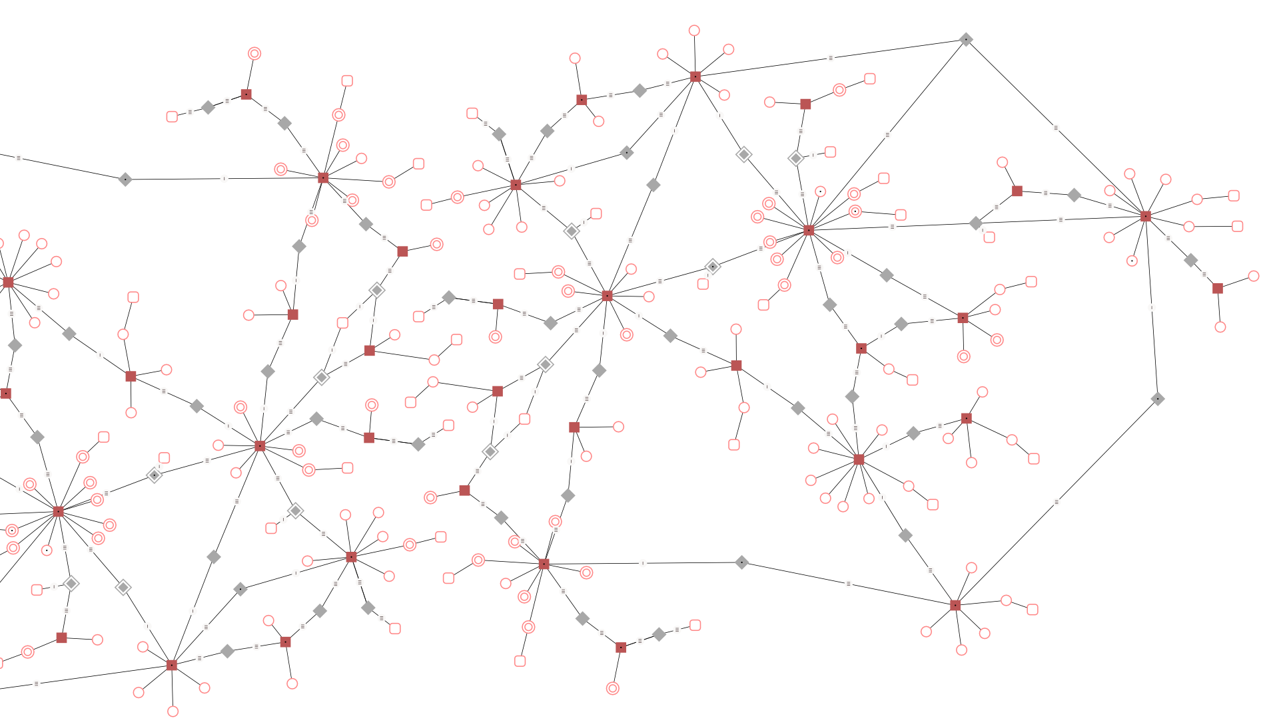
Anchor Modelling
Anchor modelling puts a conceptual framework over 6NF and provides interfaces that are in 3NF for ease of querying and utilisation.

Slide 43
What’s in a model
Components
Time
Anchors are entities
Attributes are fields
Knots are lookups
Ties are links
Static to hold just the latest value
Historized to track changes
Concurrent-reliance-temporal for muchos concepts of time*
Notes:
* Not needed for many OLTP systems – use sparingly and after investigating this

Slide 44
Model your data
Use their nifty GUI
Use XML
Yes I know, but if you don’t like it, make a JSON version PR!
From existing schema
BYO – it’s open source ☺
Notes:
From existing schema: http://www.anchormodeling.com/?p=1078

Slide 45
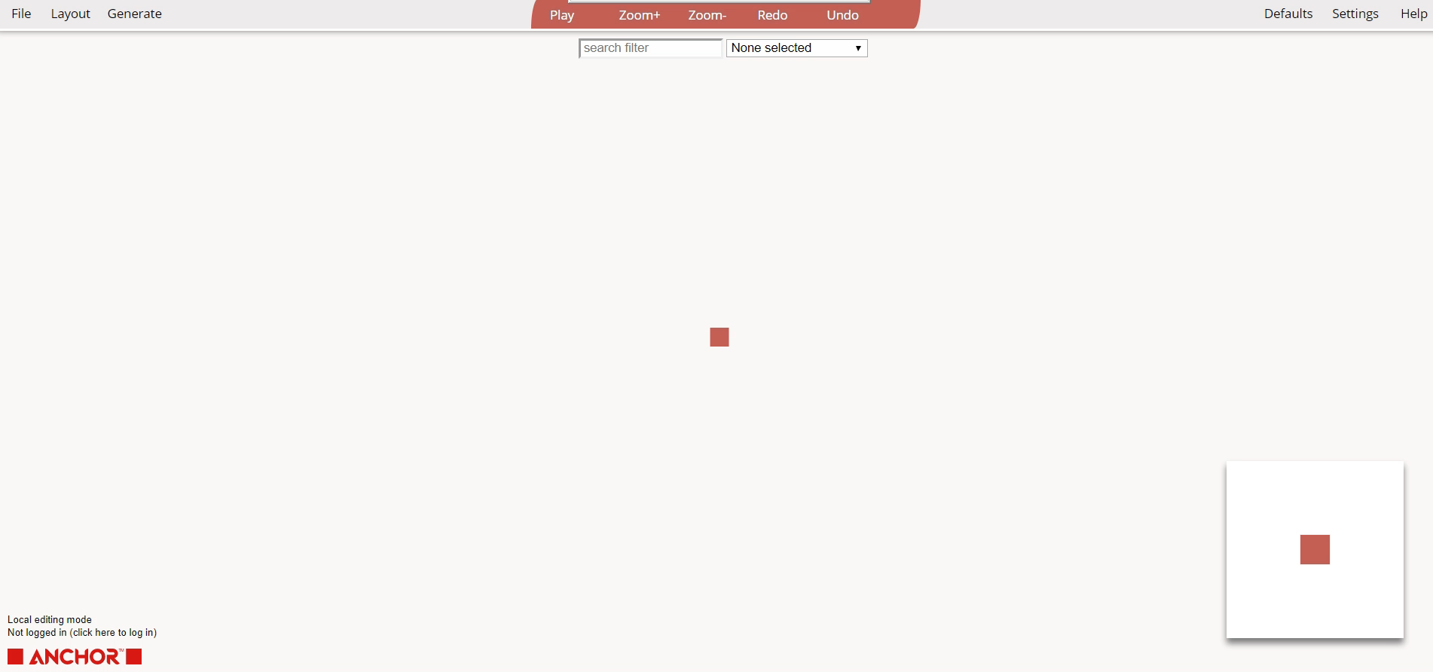

Slide 46
Don’t worry – this isn’t all or nothing, you can make part of your DB using AM.

Slide 47
Generate SQL
Use the GUI
Use the sisulate.js util
Get an idempotent script to run against your DB
The util means you can generate SQL every commit and deploy as part of pipeline
Notes:
To make comparing values easier, the anchor model utilises a CLR hashing function – as a result, you may need to adjust your security settings to use anchor model
```
exec sp_configure 'clr strict security', 0
RECONFIGURE
```

Slide 48
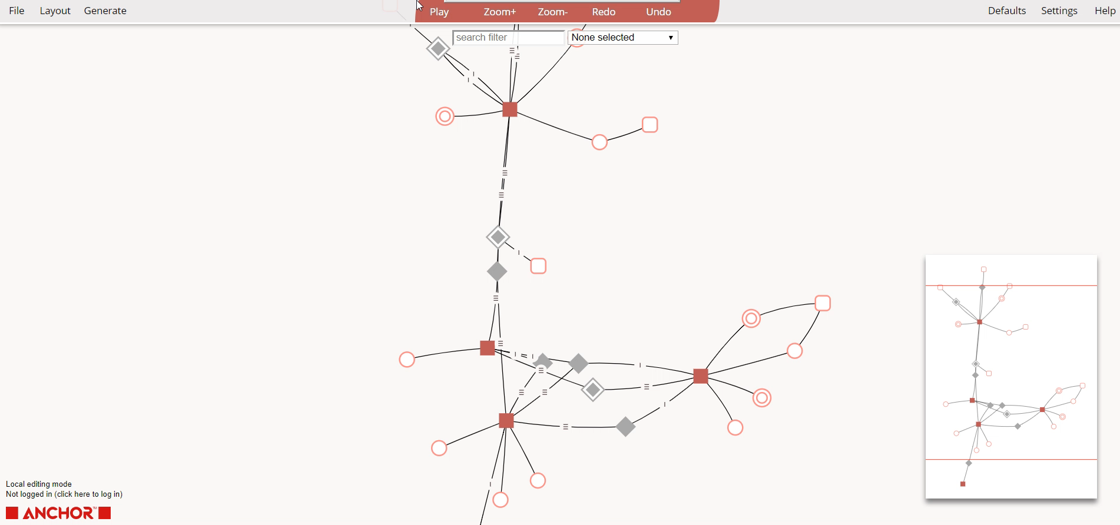

Slide 49
Use 3NF interfaces
Use pre-built interfaces that look and feel like 3NF
CRU_ like you would have previously
__D using soft delete techniques
Use latest_customer for latest records
Use point_customer() to get records at a point in time
Use difference_customer() to get all changes between two points in time
Notes:
If thinking about the right to be forgotten then you can do cascading deletes as everything has nice FK relationships and a viewable model to verify usage

Slide 51
Conclusion

Slide 52
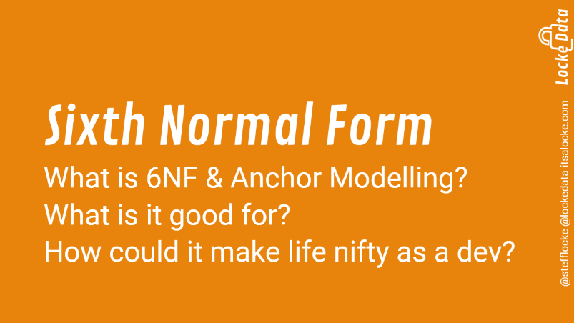


Slide 53
Thank you!
Thank you to the organisers, sponsors, and volunteers too!

Slide 54

Follow up
Q&A
Grab a card & sticker!
@stefflocke
itsalocke.com/talks
steph@itsalocke.com

